Slide 1
Java SE 8 Book Presentation
Chapter 2 – What is Java ?

Slide 2
2.1 – Understanding Java
Java is a Collection of many aspects (Separated from each other)
+) Programming language – Java is basically a Programming language, like other languages, it has its own syntax
+) Java Development Kit – Since Java is a High Level Language, it needs to be translated back to machine language => Java required its own translator (Compiler) => Java Development Kit has everything to run a Java Program (Compiler, Disassembler,…)
+) Java Virtual Machine – Different computer has different architecture (different CPU, hard drive,…) => different ways to feed the code into the processor (which mean different helper program – OS to feed code) => different compiler required to compile Java into Machine language
Java Virtual Machine – JVM is created. JVM basically is not a computer, but just a piece of software that “mimic” the real computer and runs on top of the real computer. Java engineer has identified common features of the real computer and then create JVM to simulate all of these feature. When you run a Java Program, JDK will compile it into Java Bytecode (a type of machine language that is understandable to all version of JVM), then, each different version of JVM for different OS will further compile it into machine language that is understandable to that OS => than the OS will put the code into processor for execution => JVM although has many different version but still providing same environment to run Java Program
+) Java Bytecode – As mentioned before, Java Bytecode is a type of machine language understood by JVM, these instructions wrote in Java Bytecode will be further translated by JVM into machine language that is understandable by the OS.

Slide 3
2.1 – Understanding Java
+) Java Class Library - Back before then, programmers were trying to achieve certain tasks within a single Java Program file. But as the program getting more complicated, programmers are splitting the program into multiples files for easier management and to “reuse” codes (e.g: a printing account program could split into 2 parts with a part only handle the account management, while other part handle the printing job => the printing part could be used to print the account balance or account name) => Java also has many parts like this =>They are called “Libraries” => Most of them are packaged in “Packages”. These Java libraries are called Java APIs.
+) Java Runtime Environment – JVM and Java APIs are packed into something called Java Runtime Environment. There is a term in Java called WORA – Write Once Run Anywhere => JRE makes this term possible since JRE has JVM and JVM could be able to run Java Program on any machine without need to maintain different versions of a Java Program.
One reason why Java is so successful is because all of the aforementioned aspects of Java are dependent to each other => there are no linkage between them (e.g: There are no JVM or JRE available on mobile device, but Android Studio – a development platform for Android Apps is using Java as a main programming language for the apps => Possible because Android Studio is currently using the Programming Language aspect of Java (which has no linkage to the JRE or JVM) and Android has its own compiler to compile Java code into their machine language.
The following diagram will explain the position of JVM within a computer:

Slide 4
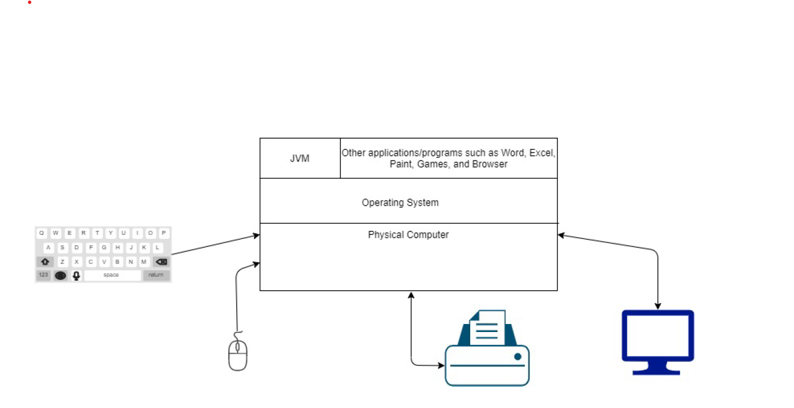
2.1 – Understanding Java
Like any other software, JVM also need to go through the OS to get the computer resources needed to mimic a same version of a physical computer

Slide 5
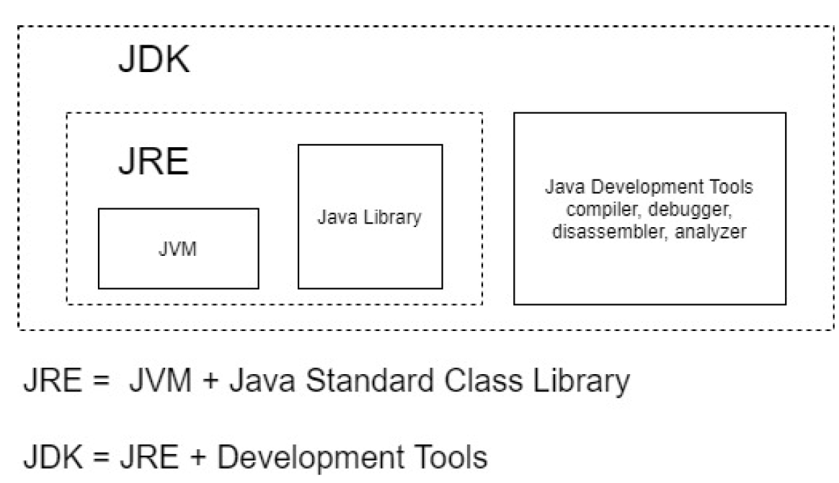
2.1 – Understanding Java
As you see JRE is included JVM and Java Library, these 2 components are needed for a Java Program to run on a machine. For developing Java program, we have JDK, which is included with JRE and other development tools (as shown).
As JDK provided many basic tools for developing Java program, 3rd parties organization such as JetBrain has developed much more powerful tools for Java development, these tools are called IDE – Integrated Development Environment, these tools contain many other things such as syntax highlight, logic error highlight,…

Slide 6
2.2 – Java Features
From Management Perspective
+) Platform Independent – thanks to JVM, Java Program could be run anywhere without any limitation
+) High Performance – Back before than, Java was very slow when compared to C/C++, but due to JVM advancement, Java is now faster
+) Secure – Java has many security feature built-in, when a Java Program runs on JVM, JVM could only have limited access to the real hardware of the real computer (which are necessary to run a program), anywhere else are inaccessible, this is possible thanks to Java Security Manager
+) Familiar – Java has a syntax system ans features that is mostly the same as C/C++, which allows C/++ devs to quickly become productive on Java
+) Simpler – Although Java is mostly the same as C/C++, many features from C/C++ has been removed such as Pointer Arithmetic, Operator Overloading, Multiple Class Inheritance, all of these features make Java hard to debug and easily get error.
+) Multiple delivery mode and deployment options – Java applications could be delivered with many options (e.g: A Java GUI apps could be delivered remotely to the client machine using Java Web Start Technology)
+) Java Ecosystem – Java devs community has developed many open source libraries for variety of uses such as PDF, encryption, mailing,…. => Make the application development in Java much faster
+) Backward Compatibility – Each of new Java update brings a lot of features, whilst maintaining the existing codes in JVM from broken => That’s why a Java Application developed on old Java version could run just fine on a newer version of JVM.

Slide 7
2.2 – Java Features
From technology perspective
+) Compiled – When we run a Java Program, it will firstly compile the code into a Java Bytecode file (usually happen in Build Process). This file then will be interpreted by JVM (as the file is already in the low level language, the run time should be better). Unlike Java, JS and PHP directly interpreted by their own interpreter (which make it very slow since it has to translate from high level language to machine language.
+) Variety of technological solutions under one umbrella – Java includes many technologies for variety of uses such as for GUI development – Java Swing
+) Multithreaded – Java support multi-threaded application development (an application where multiple tasks are happen at the same time)
+) Distributed – Java has many features to support development of distributed applications (distributed is a type of application where the client machine will handle GUI loading jobs whilst the server machine will handle data management job)
+) Garbage collection – Java has a feature that it reclaims memory section where it is no longer needed (such as unused variable or object)

Slide 8
2.2 – Java Features
From programming perspective
+) Object-oriented – Java is an Object-oriented programming language
+) Structured – Java belongs to a family type of progamming language called Structured Programming. Structured programming involves splitting large programs into smaller pieces for easier management and reuse parts. There are other family types as well such as Procedural and Functional (Java has all features of all 3 family types, e.g: Lambda Expression in Java is based on Functional Programming, whilst Procedual programming in Java is based on variable and methods)
+) Statically typed – Java is Statically Typed => which means that the variable type and the variable value must be declared at the compile time (Python is Dynamically Typed, which mean that the type of variable is determined at runtime)
+) Strongly Typed – Java is Strongly Typed => which means that once the variable or reference type is declared, that variable and reference won’t be able to point on another objects (e.g: a variable type is declared to point at integer object, then this variable cannot be pointed to float object)
+) Automatic Memory Management – Java devs cannot manage memory programmatically, which means that they cannot allocate memory by coding or even delete object and variable explicitly. All of the jobs are handled by JVM
+) Programatic Exception Handling – Java support handling exceptional situations with Try-Catch mechanism to handle unexpected situation
+) Ready-made class library – Java APIs library is huge and versatile for usage from File IO to uncommon task such as encryption

Slide 9
2.2 – Java Real life application
+) Desktop Application
+) Distributed Application
+) Web Application
+) Middleware Application (Application types that is in the middle of connection between client machine and server machine, typically handling the connection between them)
+) Server sides Application (Typically handling backend side on website)
+) Frameworks and Libraries (Frameworks mean multiple libraries)
+) Mobile Application

